Slide 1

AIRBNB HOTEL BOOKING ANALYSIS
[Tejas V]
[APPLY_175656163568b300e3a9e5d]

Slide 2

PROBLEM STATEMENT
This project has the goal of examining Airbnb's open dataset to learn about hotel booking habits, price trends, cancellation behavior, and room type preferences. Through the use of data cleaning, data visualization, and data analysis tools in Python, the project reveals valuable insights that enhance business decisions for hosts and travelers using the Airbnb platform.

Slide 3
Project Description Airbnb is one of the largest online accommodation platforms where users can book rooms, apartments, or entire homes. This project focuses on analyzing publicly available Airbnb data to identify trends and patterns related to bookings, pricing, locations, and user preferences. The analysis involves data preprocessing (cleaning and organizing raw data), exploratory data analysis (EDA), and visualization to derive insights. Using tools like Python, Pandas, Matplotlib, and Seaborn, the dataset is examined for booking trends over time, most popular neighborhoods, average pricing, cancellation policies, and room-type distribution. The results of this analysis will help understand which areas have the highest demand, how prices vary across cities, what room types are most preferred, and how cancellation policies affect bookings. The overall goal is to demonstrate how data-driven insights can be used to improve the performance and decision-making of Airbnb.

Slide 4

WHO ARE THE END USERS?
Airbnb Hosts
People Renting their home or apartments.
They Can understand price trends, popular areas, and guest preferences to optimize their listings.
Travelers or Guests
People booking stays through Airbnb.
They can use insights about prices and locations to make better travel decisions.
Airbnb Company or Data analysis
Teams that analyze platform performance.
Helps identify demand hotspots, set better recommendations, and improve platform efficiency.
Students or Researchers
Learners Studying Data analytics
Gain experience in real-world data cleaning. Visualization, and analysis using python

Slide 5

Technology Used
Python = Main programming language for analysis.
Pandas = Library used for data manipulation, cleaning, and analysis (tables, columns, missing values).
NumPy = Handles numerical operations efficiently.
Matplotlib = Used for visualizing data through graphs and charts.
Seaborn = High-level data visualization library for beautiful and insightful plots.
Jupyter Notebook / Google Colab = Environment to write, run, and visualize code interactively.
GitHub = Platform for version control and sharing final project files.
Excel (Input Dataset) = Source data format provided by Airbnb for analysis.

Slide 6
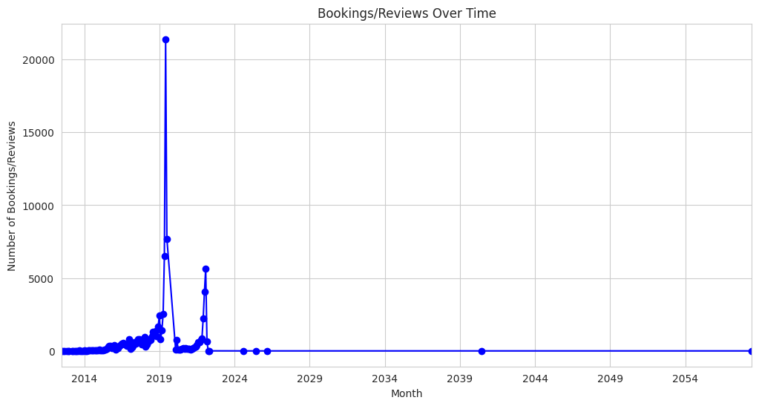
RESULTS1
[Add screen shots of your code or Chart(s) ]
Demo Link

Slide 7
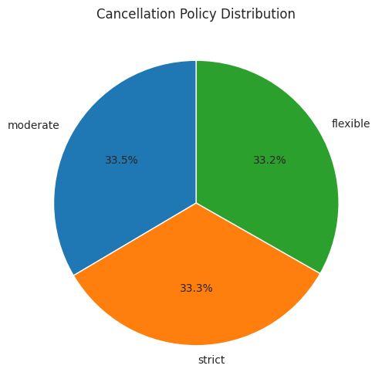
RESULTS2
[Add screen shots of your code or Chart(s) ]
Demo Link

Slide 8
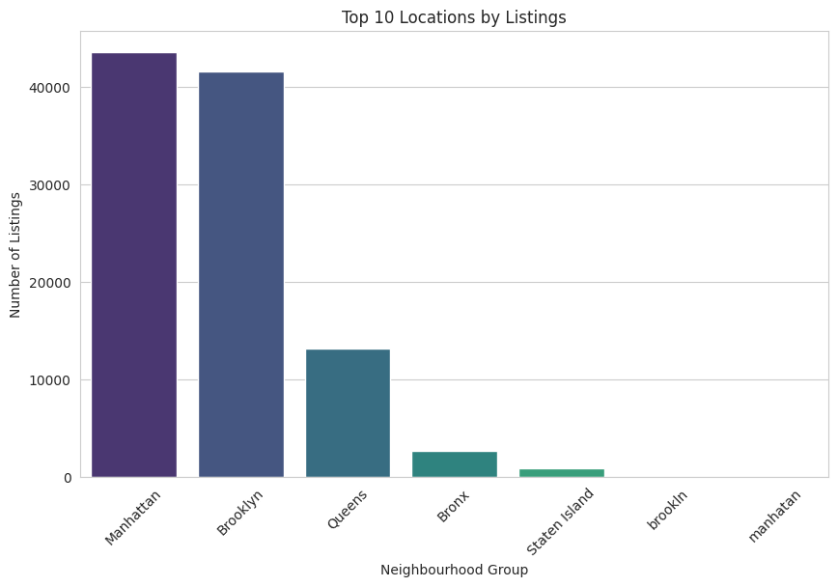
RESULTS3
[Add screen shots of your code or Chart(s) ]
Demo Link

Slide 9
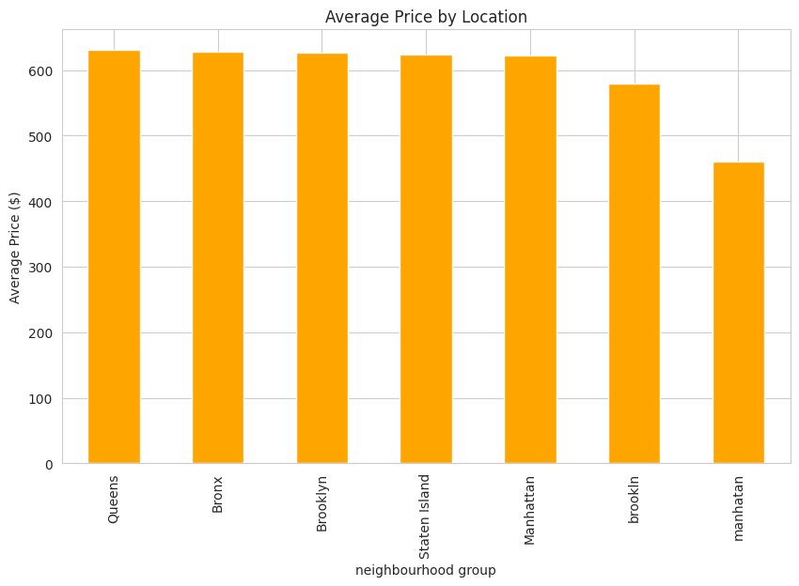
RESULTS4
[Add screen shots of your code or Chart(s) ]
Demo Link

Slide 10
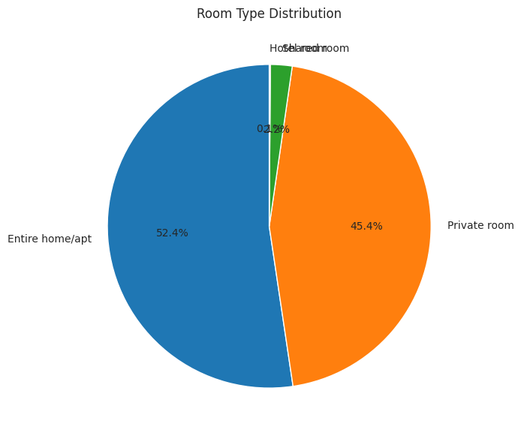
RESULTS5
[Add screen shots of your code or Chart(s) ]
Demo Link

Slide 11
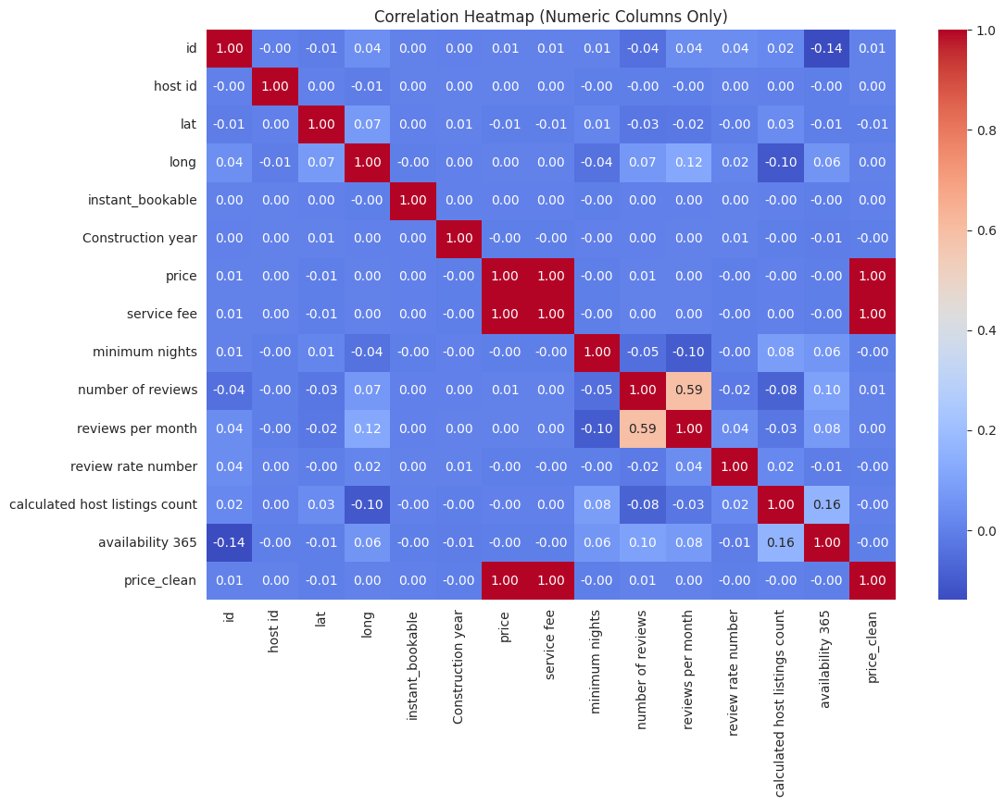
RESULTS6
[Add screen shots of your code or Chart(s) ]
Demo Link

Slide 12
GitHub repository
https://github.com/Tejkv/VOIS_AICTE_Oct2025_Tejas-V.git
Demo Link

Slide 13
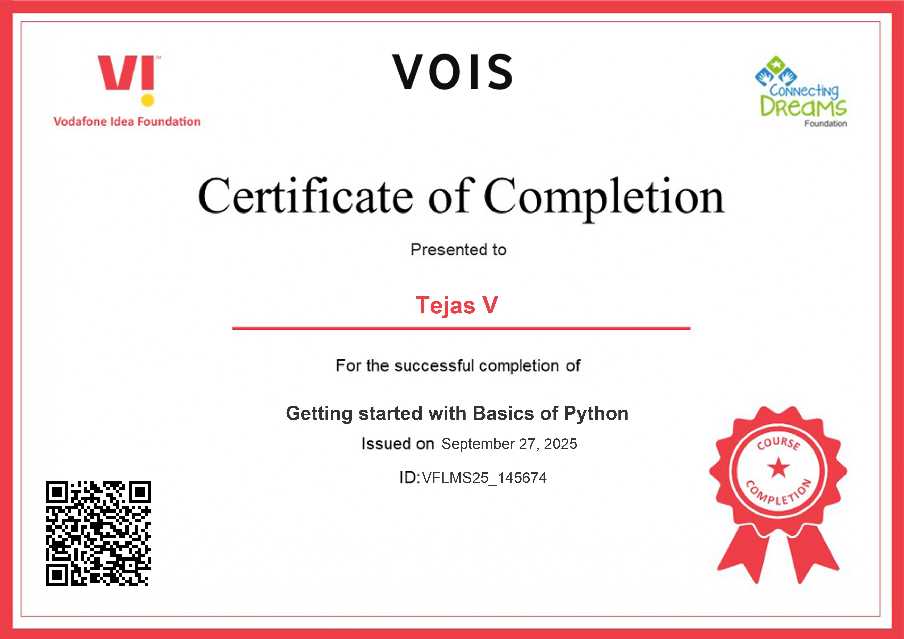
Getting started with Basics of Python Certificate
[Paste your Certificate Here]

Slide 14
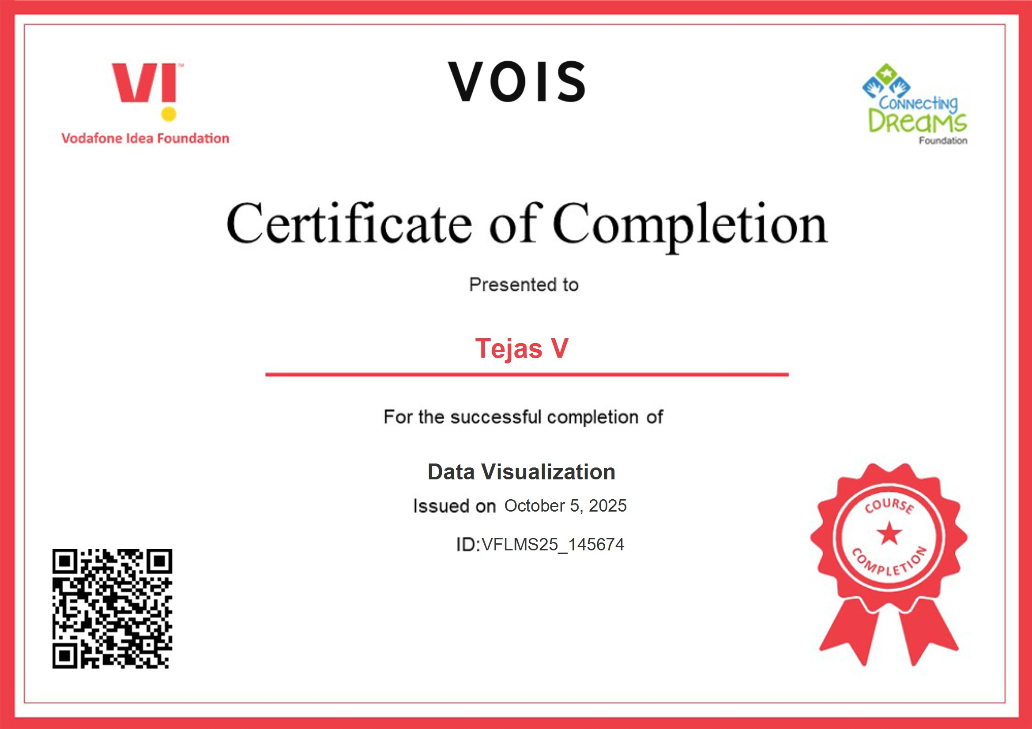
Data Visualization Certificate
[Paste your Certificate Here]

Slide 15
Thank you
.
.

